Slide 1
Shadow & Eye: Building a Mind-Bending Metroidvania
Team: Naor, Majd, Daniel, Or [LOGO: College Logo] [LOGO: Unity Logo]
Notes:
Main Visual: Captivating splash screen/key art for "Shadow & Eye."
Logos: Your College Logo, Unity Logo (bottom corners).
(Verbal Cue for your practice): "Hi everyone, we're [Team Name]. We're excited to show you 'Shadow & Eye' – a 2D Metroidvania where you literally arm yourself with the essence of your inner conflicts, and how we engineered that experience." Estimated Time: 20 seconds

Slide 2
About: What if Your Mind Was a Real Place?
Concept: Mind as an explorable world.
Game: 2D Metroidvania – arm yourself with inner demons.
Player: Shadowy figure + Eye companion.
Core Mechanic: Absorb enemy essence -> new powers (combat/traversal).
[IMAGE/GIF: Shadow character running, Eye zaps a defeated enemy, Shadow character now has a new glowing weapon or dashes differently]
Notes:
Speaker Notes: (You'll deliver this verbally) So, what if your mind was a real place you could explore? And what if those inner battles were actual monsters? In 'Shadow & Eye,' our 2D Metroidvania, you don't just fight inner demons – you literally take their powers! You play as this shadowy figure with a cool floating Eye companion. As you beat enemies, The Eye absorbs their powers, giving you awesome new abilities to fight and explore this 'mind-world'.

Slide 3
Story: Trouble in the Mind-World
Problem: the world became imbalanced and distorted due to conflict between Vego and Verona.
Fallout: Ecosystem chaos; good thoughts corrupt; will weakens.
Quest: shadow charcter + Eye journey to restore balance.
[IMAGE: A cool central location in the game, but it looks a bit broken or dark] [IMAGE/ANIMATION: Simple animation of a friendly-looking game creature turning into a spiky, mean one]
Notes:
Speaker Notes: (You'll deliver this verbally) The story is that the 'control center' of this mind-world gets taken over by a pretty deceptive force. This messes everything up – good thoughts turn into nasty creatures, and the mind's ability to make clear decisions gets weak. You, as this kind of outcast shadow character, have to journey with The Eye to try and set things right.

Slide 4
Philosophy: Fun with a Deeper Meaning
Aim: Fun game exploring self-discovery & inner challenges.
Mechanics as Metaphors:
New Powers: Learning from challenges.
Enemies: Internal hurdles.
Game Areas: Three big areas representing the different aspects of the mind.
Goal: Engaging adventure, subtly thought-provoking.
[IMAGE: Abstract art that feels a bit introspective, or a character looking thoughtfully at different paths]
Notes:
Speaker Notes: (You'll deliver this verbally) Our main goal was to make a really fun Metroidvania that also touches on deeper ideas like self-discovery. So, when you get new powers, it's kind of like growing from challenges. The enemies are like those internal struggles, and the different game areas are like different moods. We wanted it to be an adventure that makes you think a bit, but mostly is just fun to play.

Slide 5
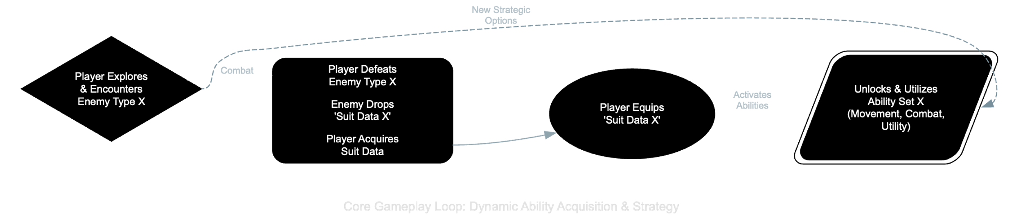
Project Goals: Building a Cool & Flexible Game
Flexible Power System:
Easily add new enemy powers.
Support diverse playstyles.
Smooth Combat & Movement:
Impactful abilities; fluid tactical adaptation.
Maintainable Code:
Smart structure for future expansion.
Tech Stack: Unity (2022 LTS), C#, URP, Input System, A* Pathfinding.
[IMAGE/GIF: Player using a couple of very different powers]
Notes:
Speaker Notes: (You'll deliver this verbally) Tech-wise, our main goals were a super flexible power-up system – so we could easily add new abilities from enemies without rewriting tons of code. We also wanted combat and movement to feel really smooth and let players adapt. And, of course, write code that's easy to manage and expand. We built it all in Unity, using C#, URP for graphics, the new Input System, and A* for enemy pathfinding.

Slide 6
The Tough Parts: Making it All Happen
Many Powers: Managing ability complexity without messy code.
Quick Power Swaps: Ensuring natural, intuitive control.
Thematic Mechanics: Connecting powers/enemies to game themes.
System Interplay: Independent yet coordinated game parts.
[IMAGE: A question mark icon or a lightbulb icon]
Notes:
Speaker Notes: (You'll deliver this verbally) Of course, we hit some challenges. Like, how do we manage all these unique player powers without the code getting super messy? How do we make switching between powers feel good? How do we make sure the game mechanics actually connect to our deeper themes? And how do we get all the different parts of the game to talk to each other without creating a tangled web?

Slide 7
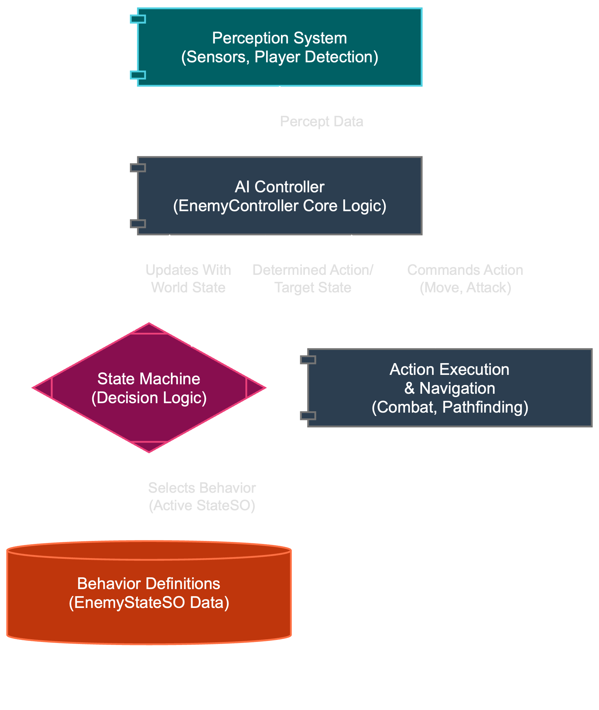
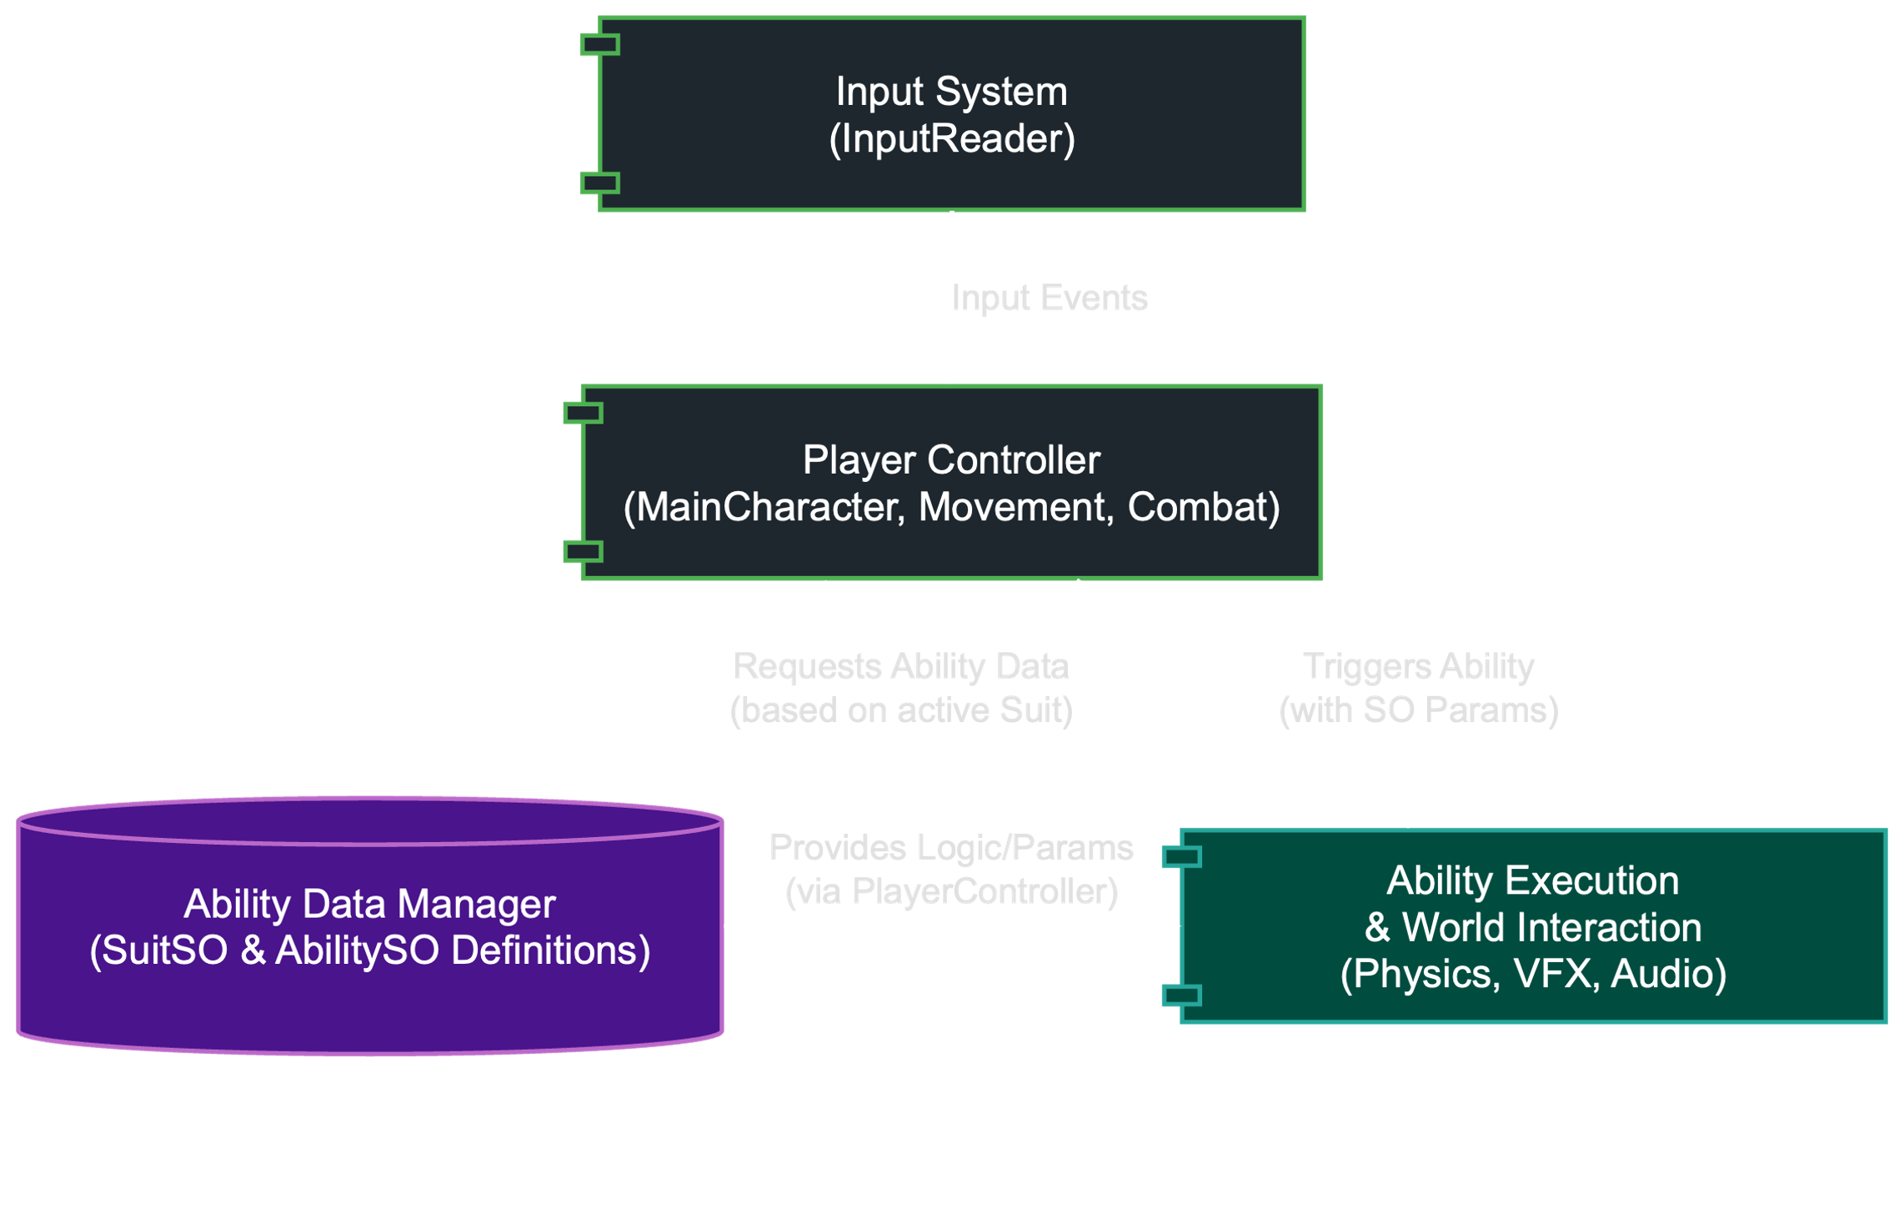
How We Solved It (Part 1): Smart Data & Key Patterns
Foundation: Unity Component-Based Design.
#1: ScriptableObjects (SOs) - Data-Driven Design:
Powers & Enemy AI defined as data files (SOs).
New Power/Enemy = New Data, not new complex code.
Benefit: Flexible, easy iteration, thematic integration.
#2: Strategy Pattern (Player Powers):
Player swaps "game plans" (power sets) from absorbed essences.
Benefit: Fluid playstyle changes.
Notes:
Speaker Notes: (You'll deliver this verbally) So here's how we tackled those challenges. Our main trick was using ScriptableObjects a LOT. Think of these as data files that tell the game how abilities work or how enemies should behave. This means adding a new power is mostly like adding a new data file, not rewriting a bunch of code. For player powers, we used the Strategy pattern – which just means the player can easily swap their 'game plan' based on the enemy power they're using.

Slide 8
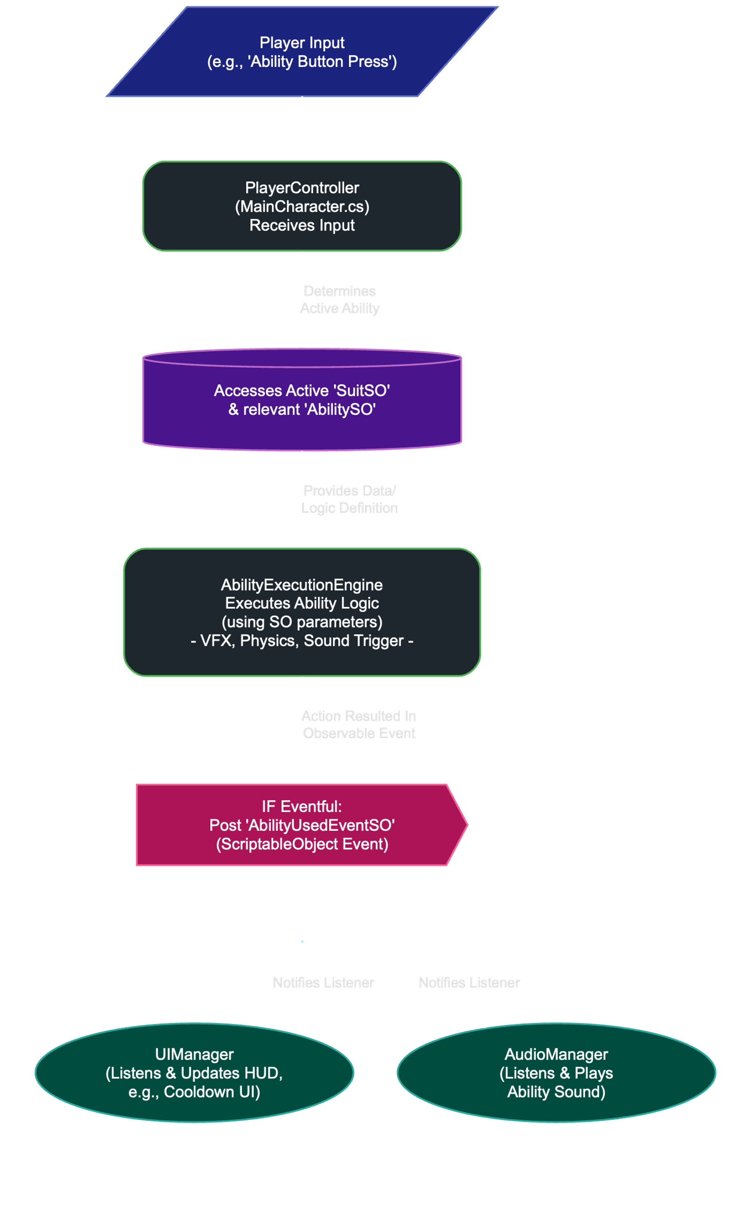
How We Solved It (Part 2): System Flow & Communication
#3: State Pattern (Enemy AI & Game Flow):
Enemies: Clear behavior states (idle, chase, attack).
Game: Defined states (menu, playing, paused).
Benefit: Organized, debuggable complex behaviors.
#4: Observer Pattern (SO Event Channels - "Notice Board"):
Event happens (player hit) -> posts "notice" (SO Event).
Other systems (UI, sound) react if interested. No direct links.
Benefit: Decoupled systems, cleaner code, maintainable.
Key Tech: URP (visuals), A* Pathfinding (enemy nav).
Notes:
Speaker Notes: (You'll deliver this verbally) Enemies and the game's flow use the State pattern, which keeps their behaviors organized. And for getting different systems to communicate, we used ScriptableObject Event Channels – it's like a digital notice board. When something happens, a notice gets posted, and any system that cares can react. This keeps everything nicely separated. Plus, URP helped us make the different 'mind-zones' look cool, and A* makes enemies chase you properly.

Slide 9
So, Did Our Plan Work?
Added 3 diverse powers; minimal core changes.
Smooth performance and game feel.
Decoupled system: easier debugging & additions.
[IMAGE/GIF: Short GIF showing off a few different cool powers in action]
Notes:
Speaker Notes: (You'll deliver this verbally) And yeah, this approach worked out pretty well! We were able to add a bunch of unique player abilities without massive headaches, the game runs smoothly, and because our code is organized, fixing things and adding features has been manageable.

Slide 10
The Coolest Part & What's Next
Proudest Of: Deep ideas linked to gameplay via flexible, data-driven design.
Future: More powers, crazier "demons," expanded world, finish story.
[IMAGE: An exciting in-game shot or a piece of concept art hinting at future areas]
Notes:
Speaker Notes: (You'll deliver this verbally) What we're most proud of is how the game's deep ideas are built right into the gameplay, thanks to our flexible, data-driven systems. For the future, we'd love to add more powers, crazier enemies, new areas of the mind-world to explore, and wrap up the story.

Slide 11
Questions?
Team: Naor, Majd, Daniel, Or [TEXT: Your Portfolio/Project Link (Optional)]
[IMAGE: "Shadow & Eye" logo]
Notes:
Speaker Notes: (You'll deliver this verbally) Thanks for listening! Any questions?

